Slide 1
PG & RESEARCH DEPARTMENT OF ZOOLOGY Government arts college, coimbatore
EDUCATIONAL TOUR – MYSORE & COORG
I M.Sc. ZOOLOGY
06. 01. 2015 to 08. 01. 2015

Slide 3
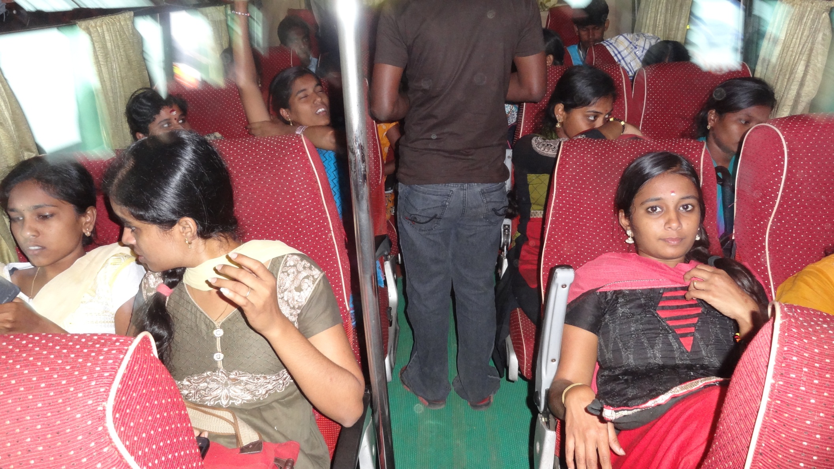
EDUCATIONAL TOUR-COORG & MYSORE

Slide 4
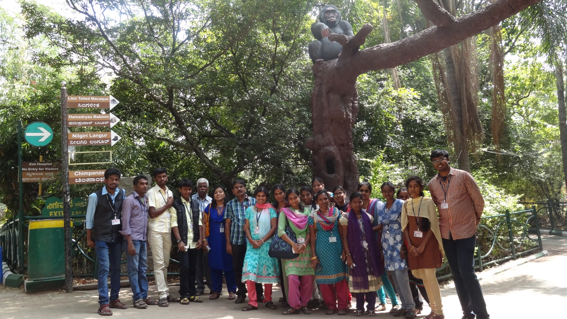
EDUCATIONAL TOUR - MYSORE
SRI CHAMARAJENDRA ZOOLOGICAL GARDENS (06.01.2015)

Slide 5
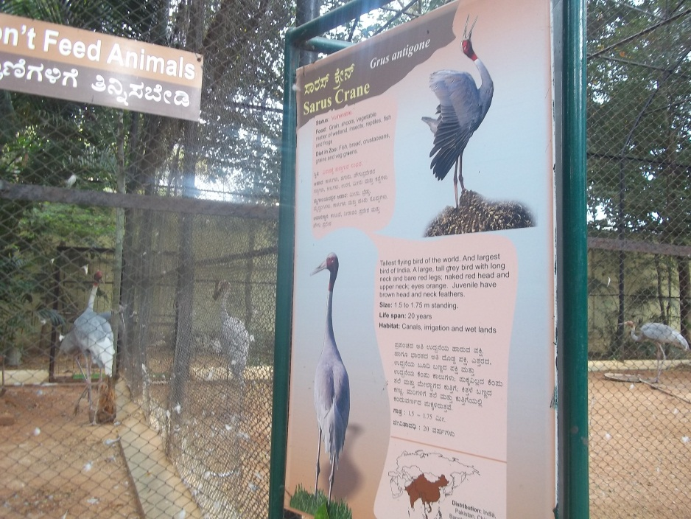
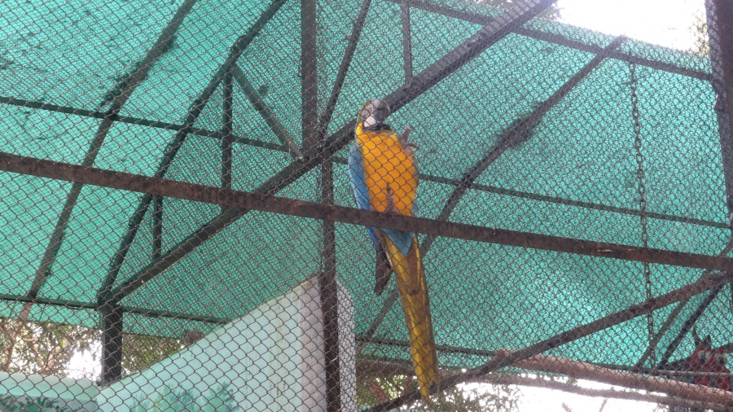
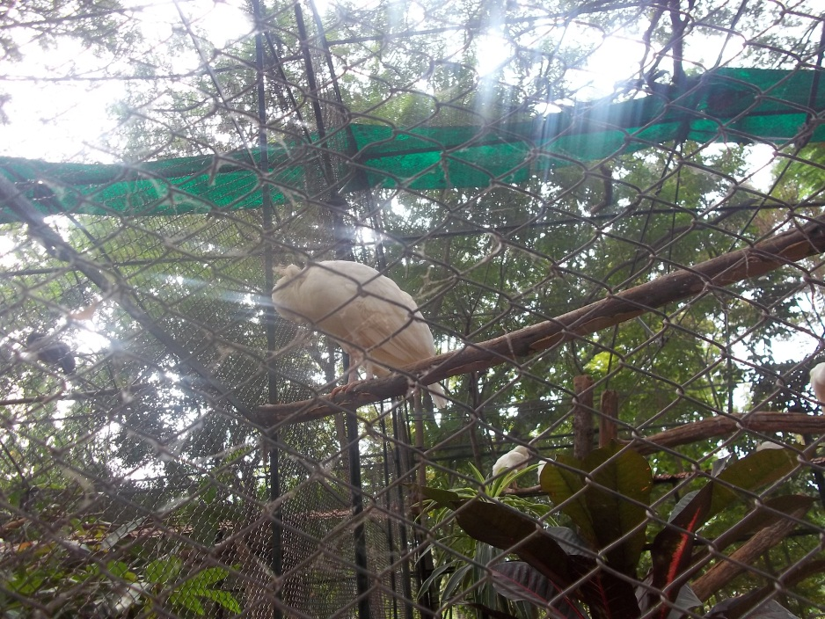
EDUCATIONAL TOUR - MYSORE
ZOOLOGICAL GARDENS (06.01.2015)

Slide 6
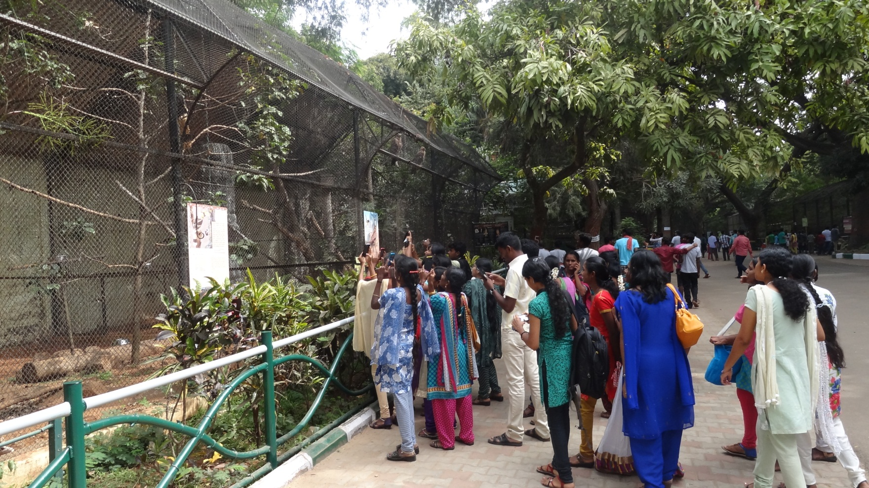
EDUCATIONAL TOUR - MYSORE
ZOOLOGICAL GARDENS (06.01.2015)

Slide 7
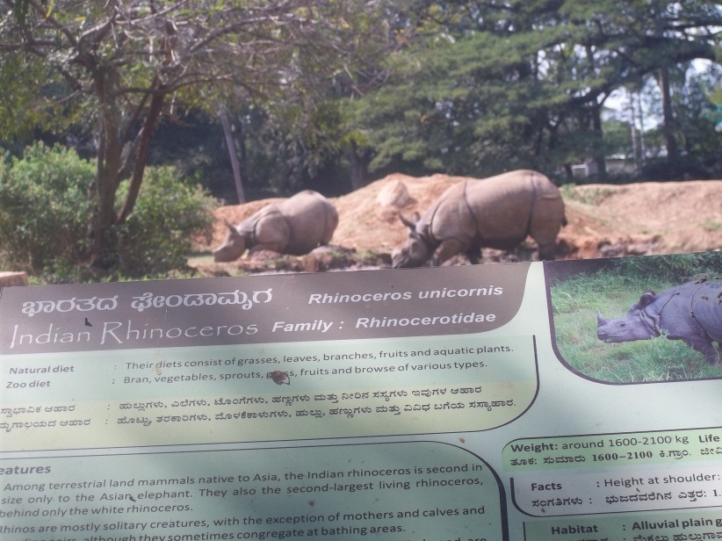
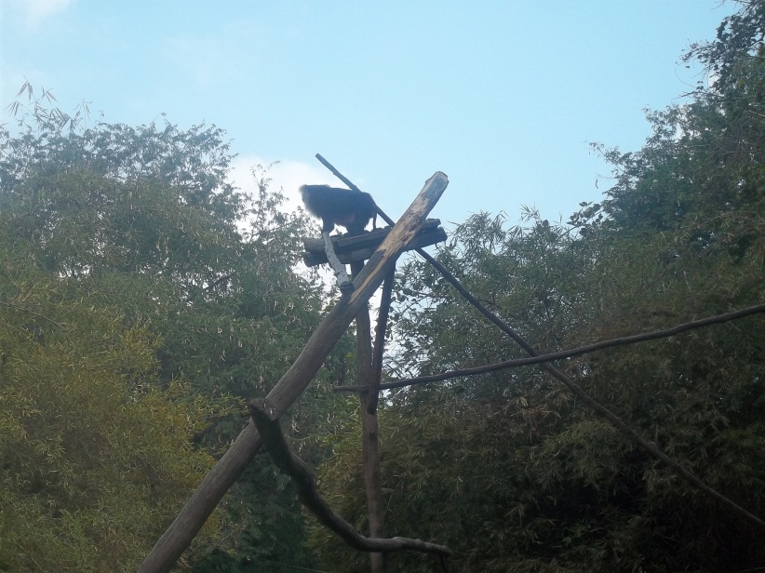
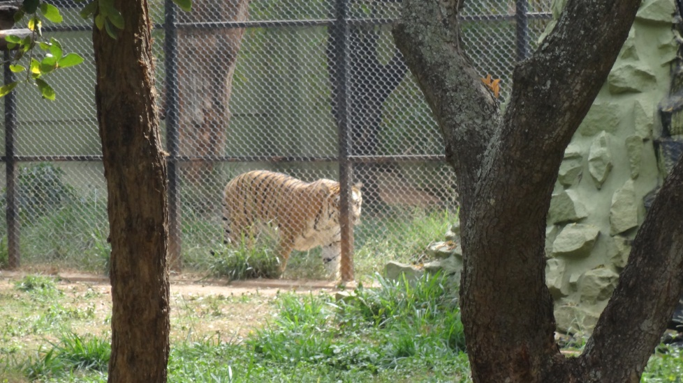
EDUCATIONAL TOUR - MYSORE
ZOOLOGICAL GARDENS (06.01.2015)

Slide 8
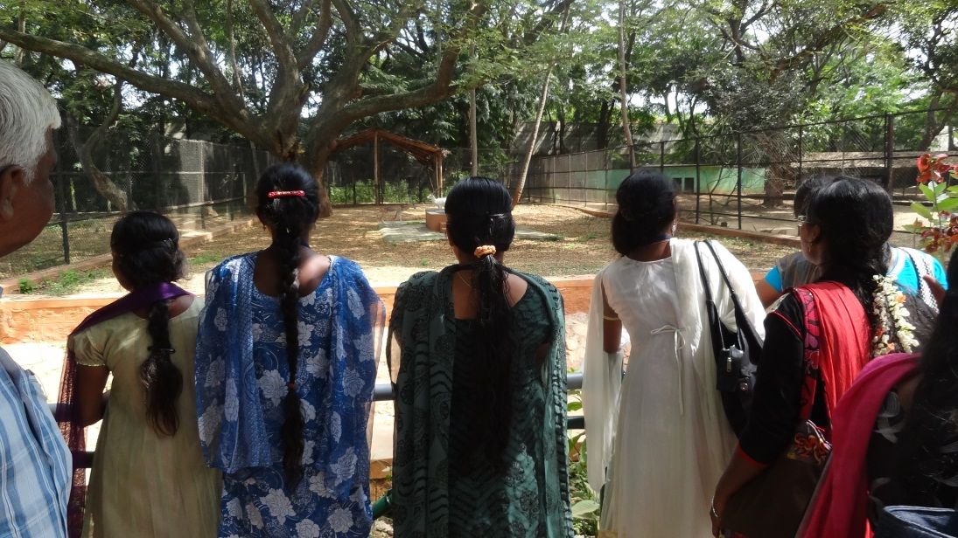
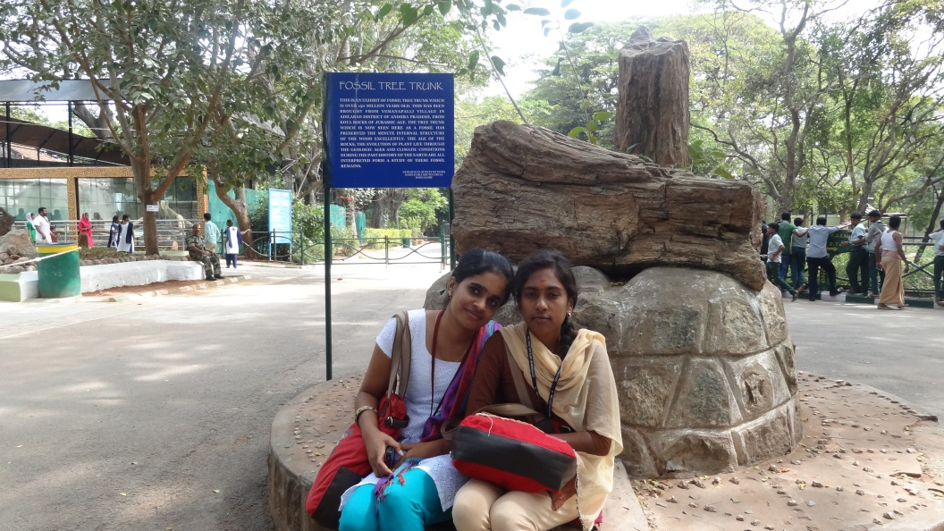
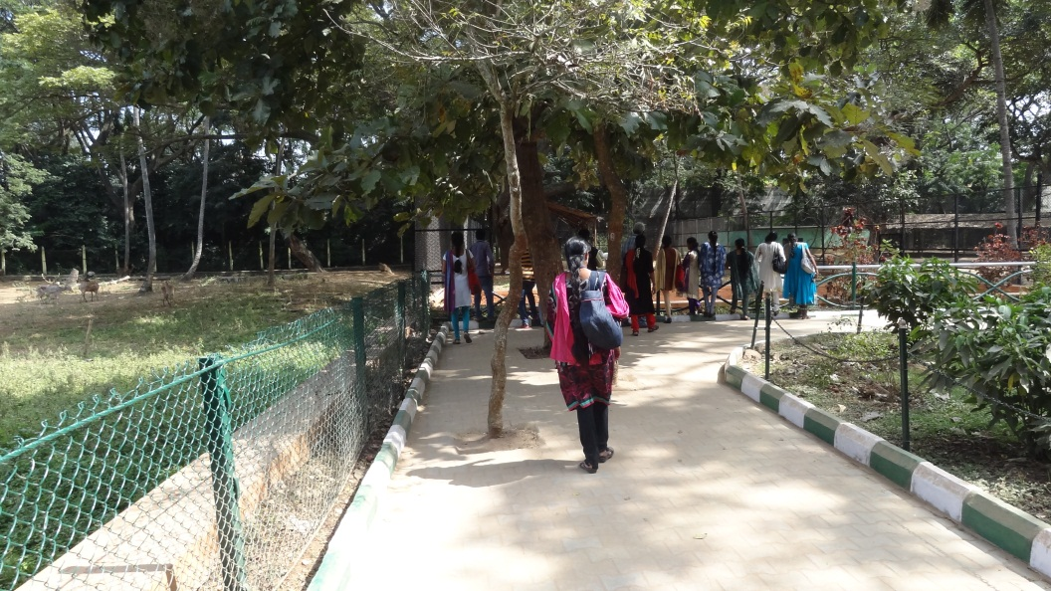
EDUCATIONAL TOUR - MYSORE
ZOOLOGICAL GARDENS (06.01.2015)

Slide 9
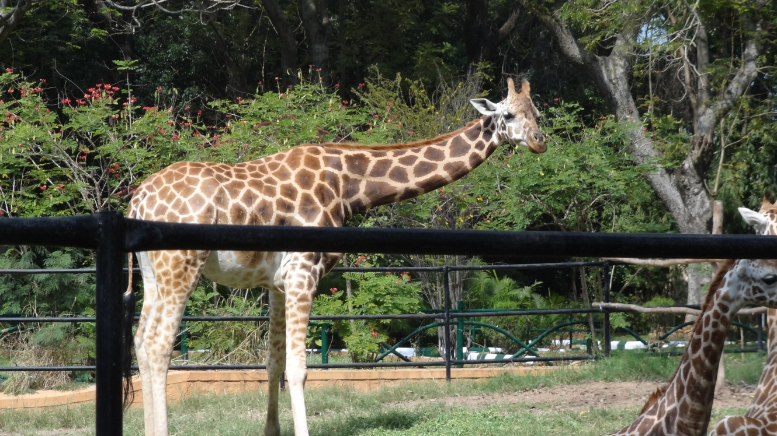
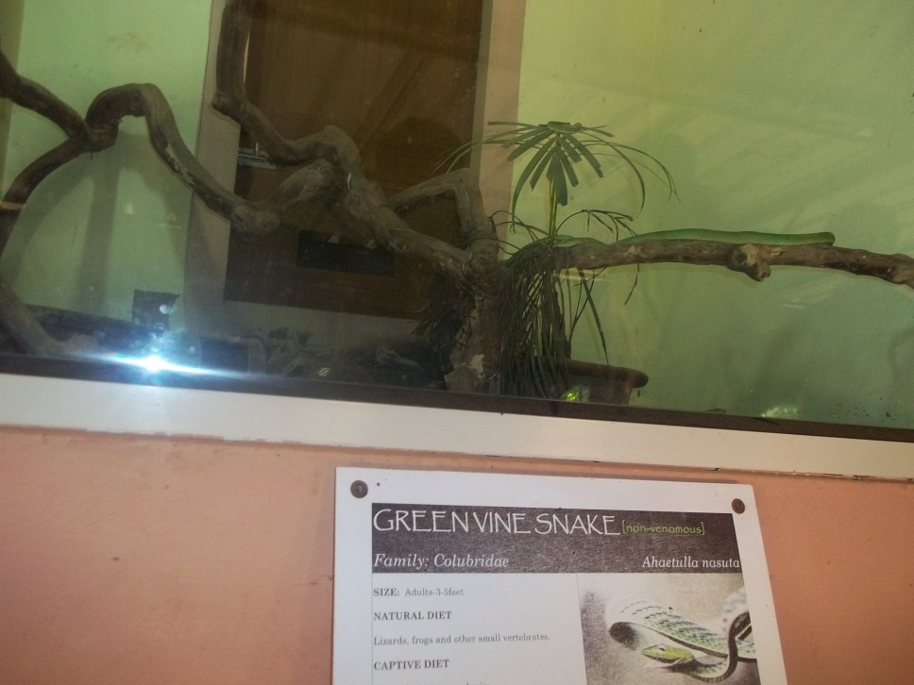
EDUCATIONAL TOUR - MYSORE
ZOOLOGICAL GARDENS (06.01.2015)

Slide 10
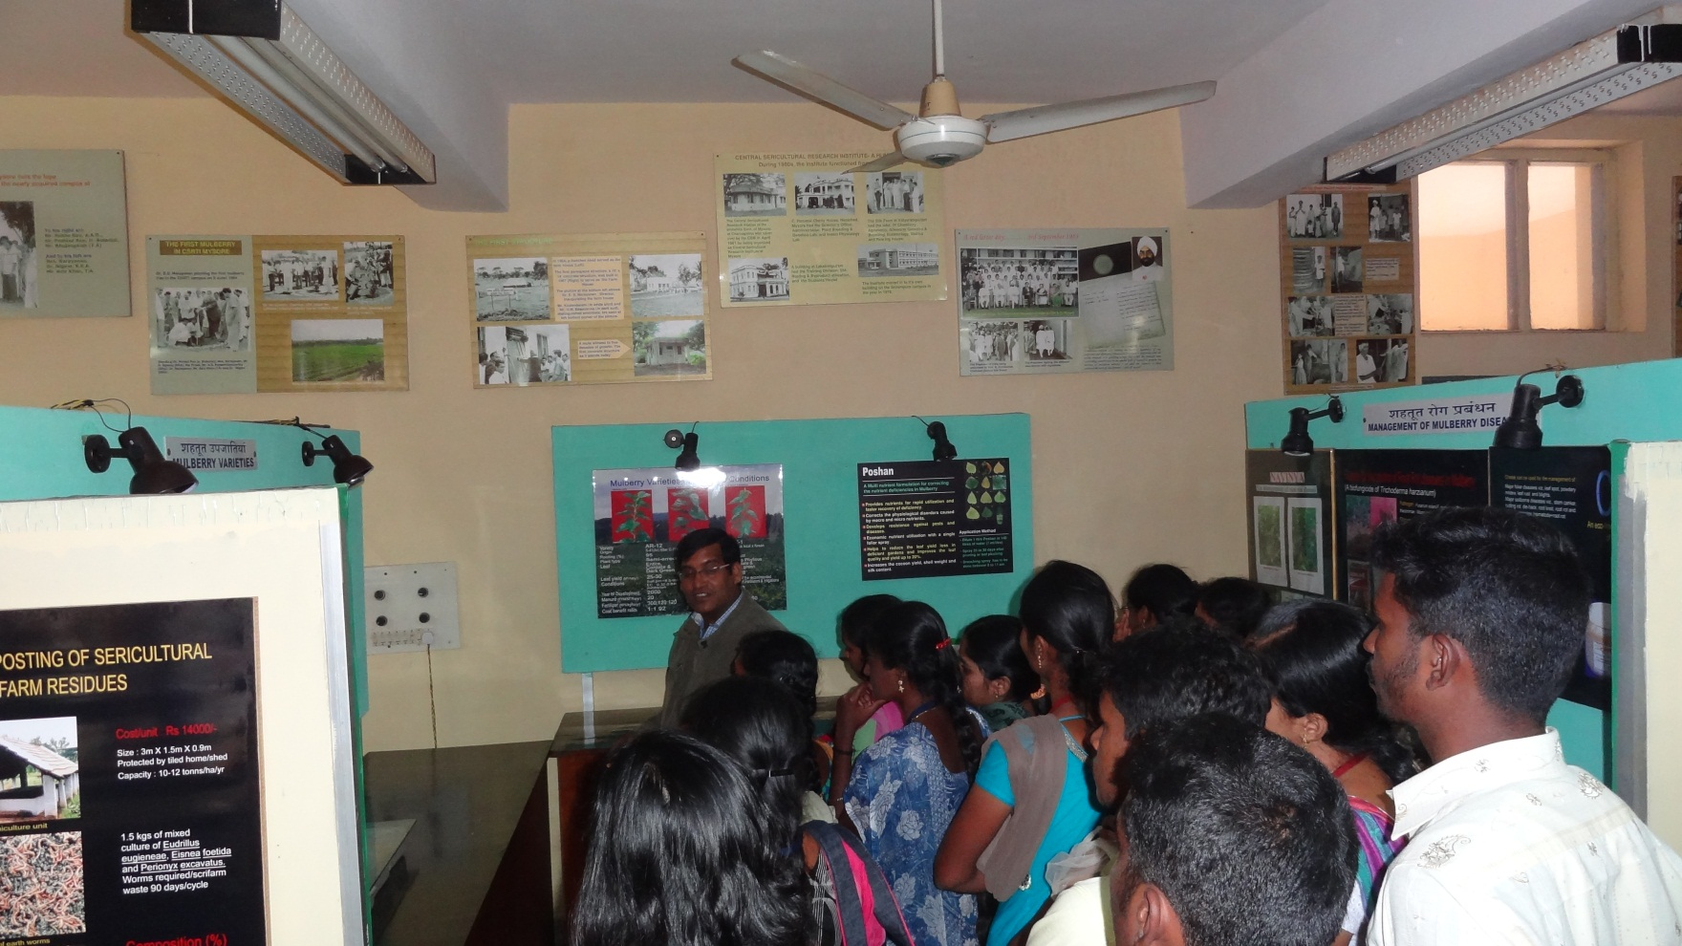
EDUCATIONAL TOUR - MYSORE
CENTRAL SERICULTURAL RESEARCH & TRAINING INSTITUTE (06.01.2015)

Slide 11
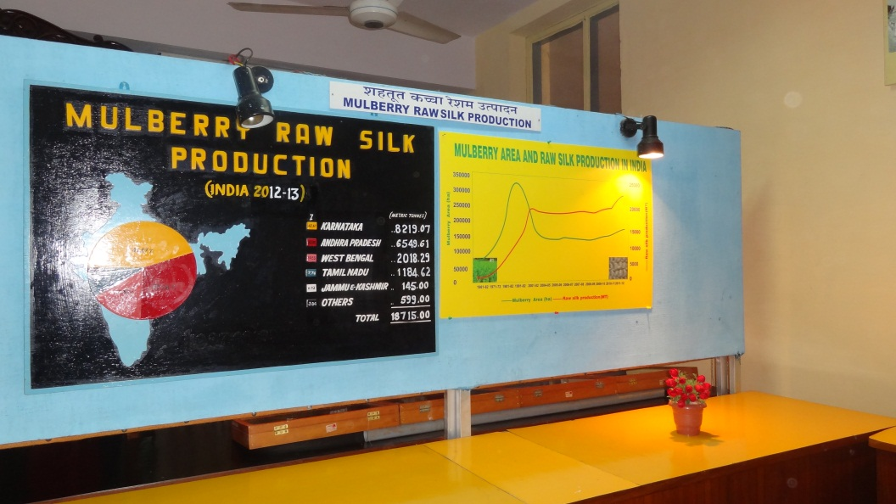
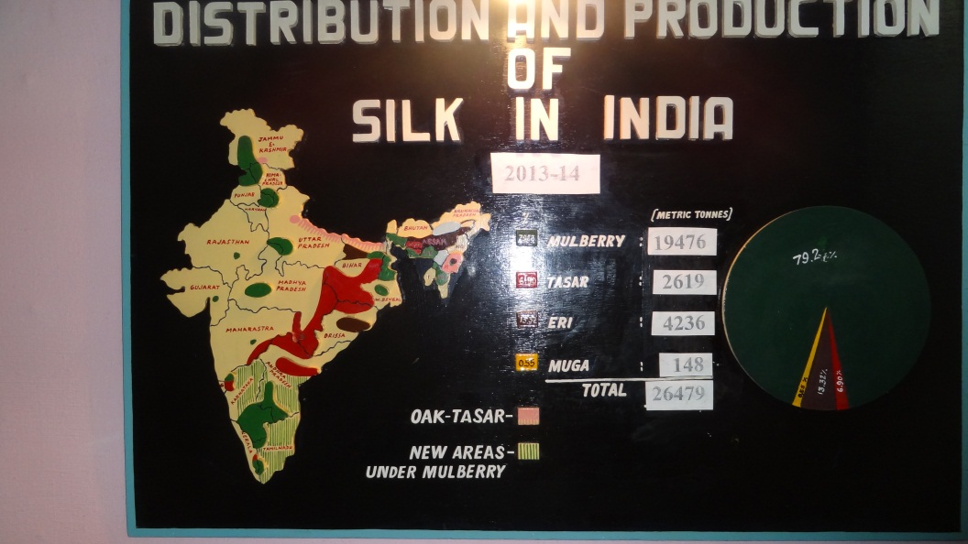
EDUCATIONAL TOUR - MYSORE
CENTRAL SERICULTURAL RESEARCH & TRAINING INSTITUTE (06.01.2015)

Slide 12
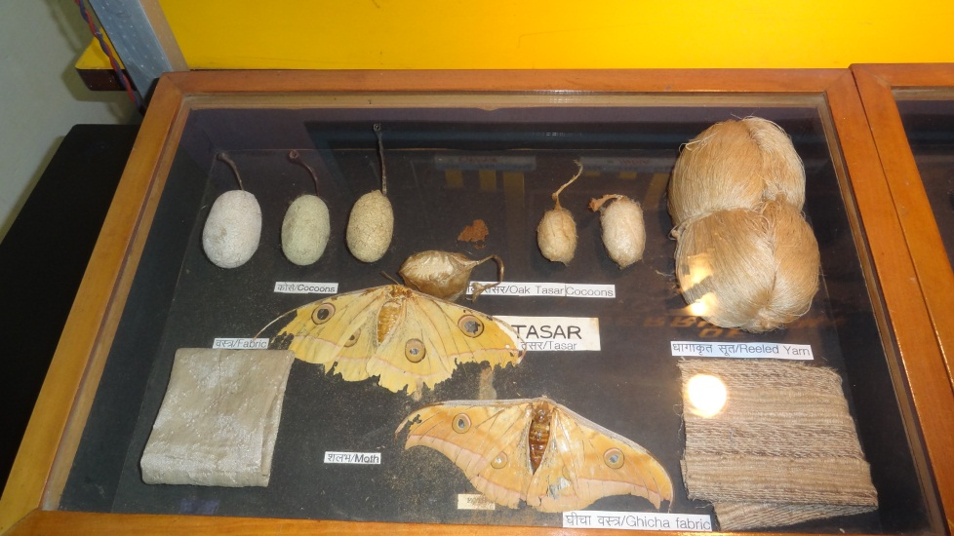
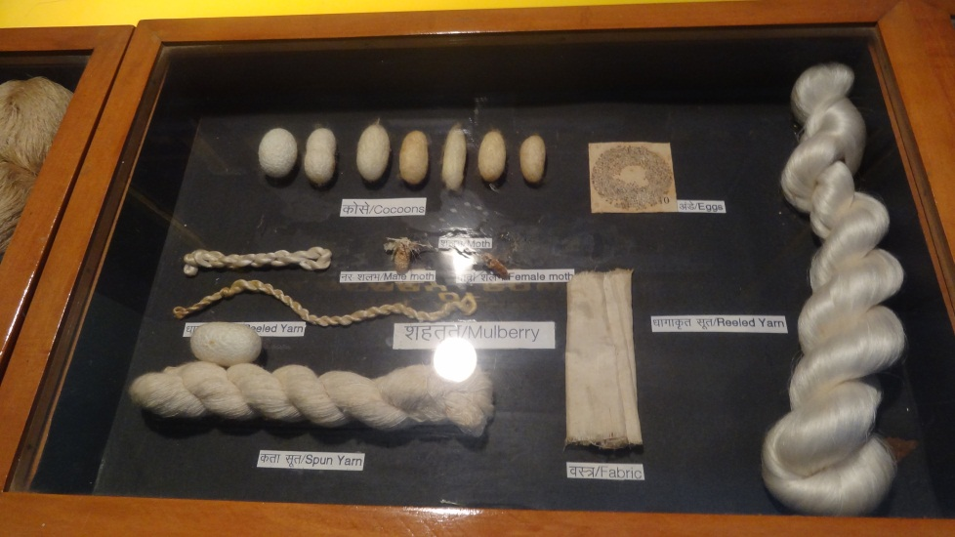
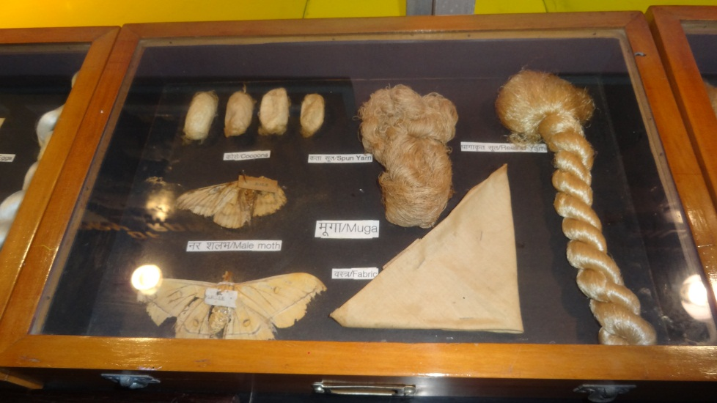
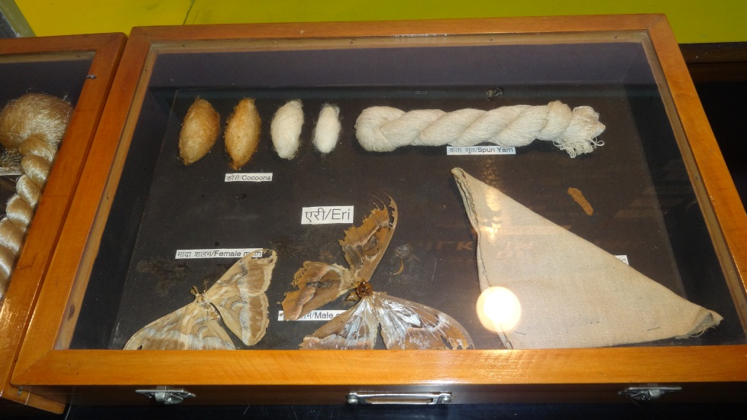
EDUCATIONAL TOUR - MYSORE
CENTRAL SERICULTURAL RESEARCH & TRAINING INSTITUTE (06.01.2015)

Slide 13
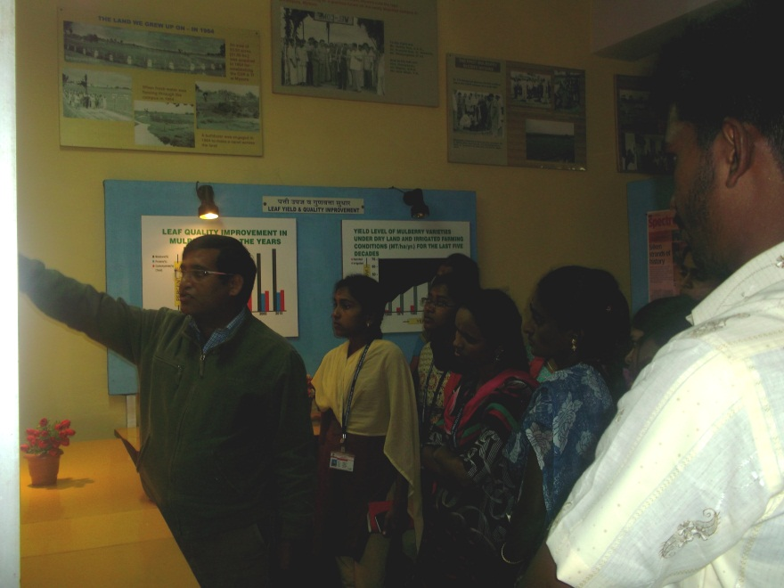
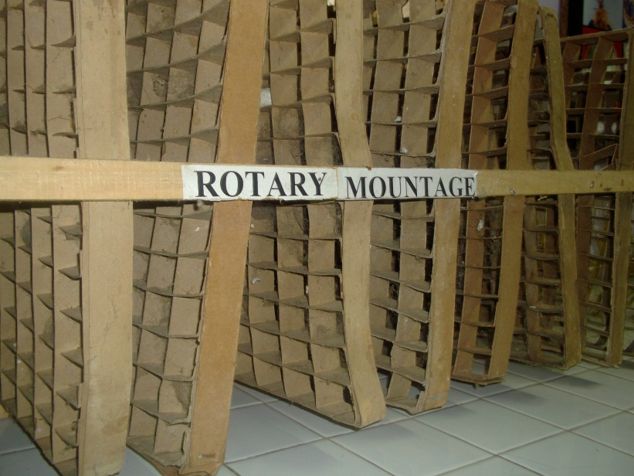
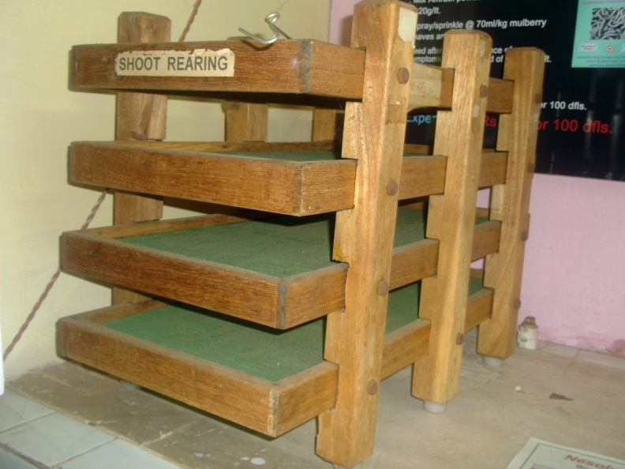
EDUCATIONAL TOUR - MYSORE
CENTRAL SERICULTURAL RESEARCH & TRAINING INSTITUTE (06.01.2015)

Slide 14
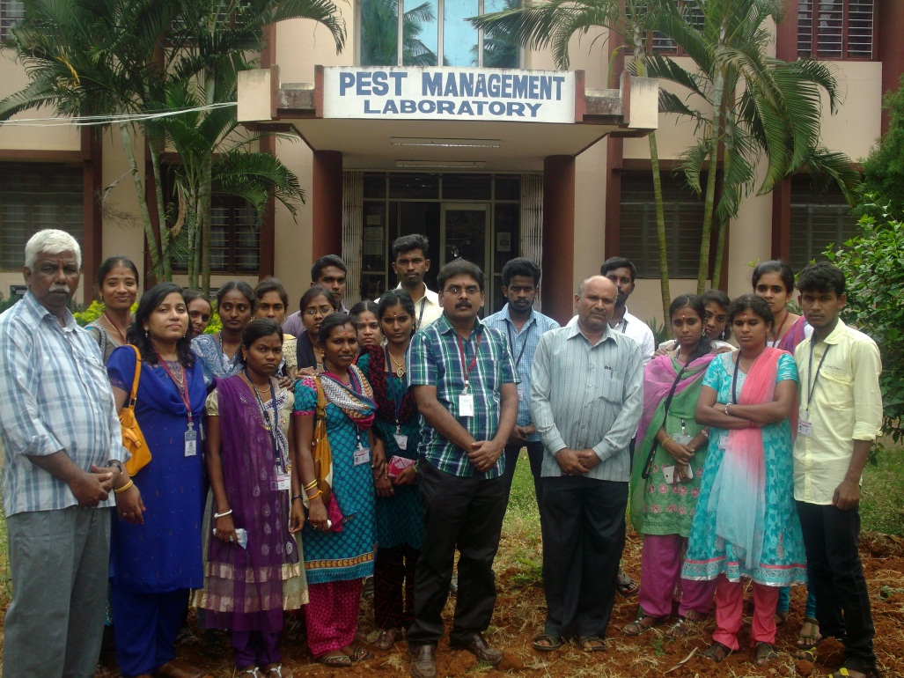
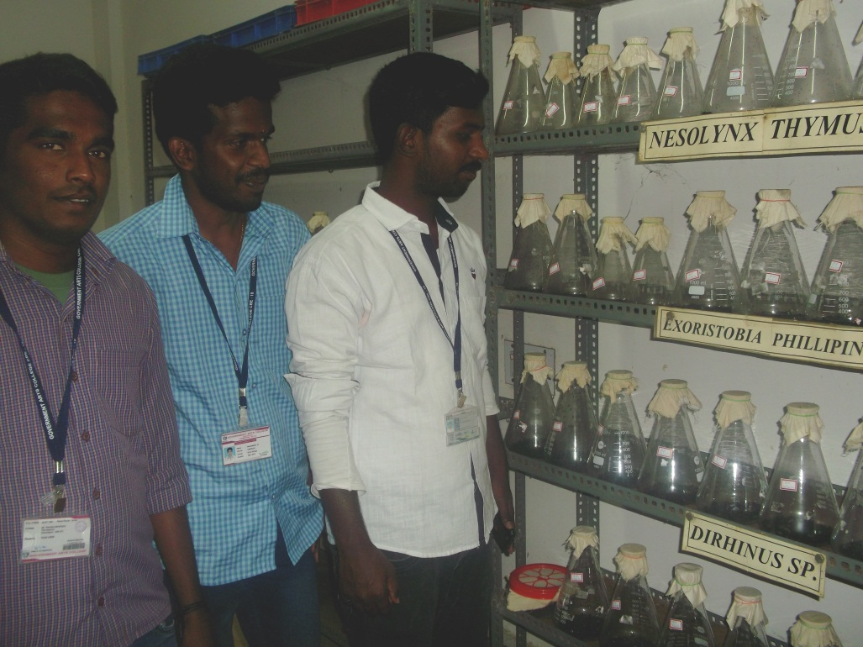
EDUCATIONAL TOUR - MYSORE
CENTRAL SERICULTURAL RESEARCH & TRAINING INSTITUTE (06.01.2015)

Slide 15
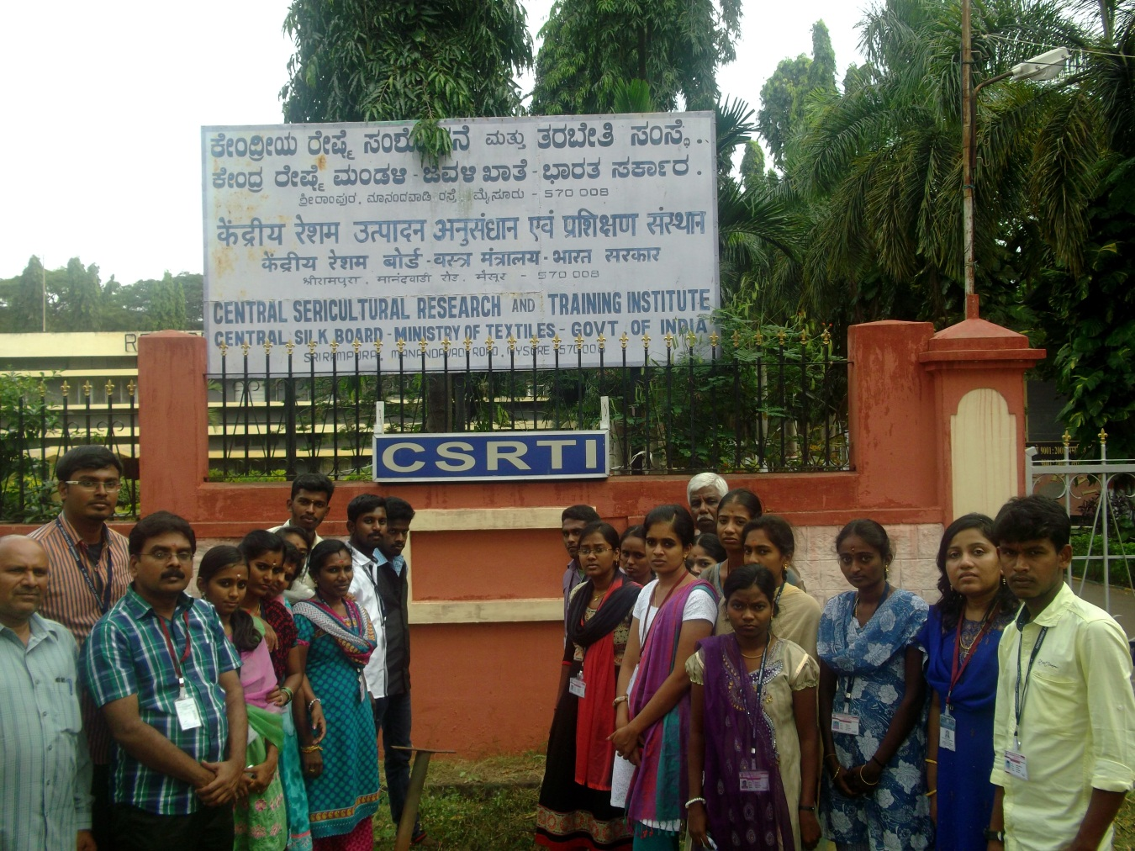
EDUCATIONAL TOUR - MYSORE
CENTRAL SERICULTURAL RESEARCH & TRAINING INSTITUTE (06.01.2015)

Slide 16
EDUCATIONAL TOUR - COORG

Slide 17
EDUCATIONAL TOUR - COORG

Slide 18
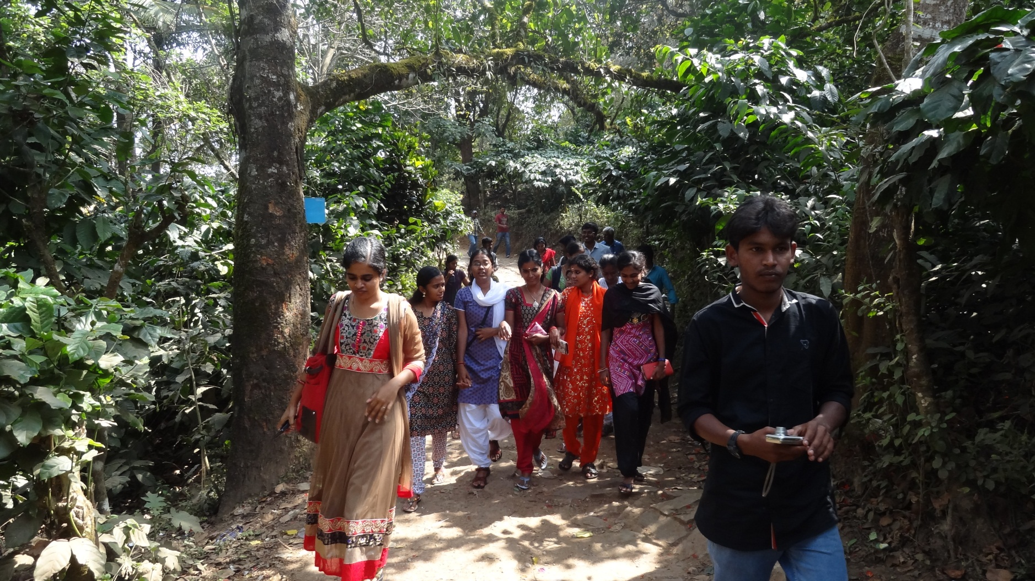
EDUCATIONAL TOUR - COORG
ABBEY FALLS (07.01.2015)

Slide 19
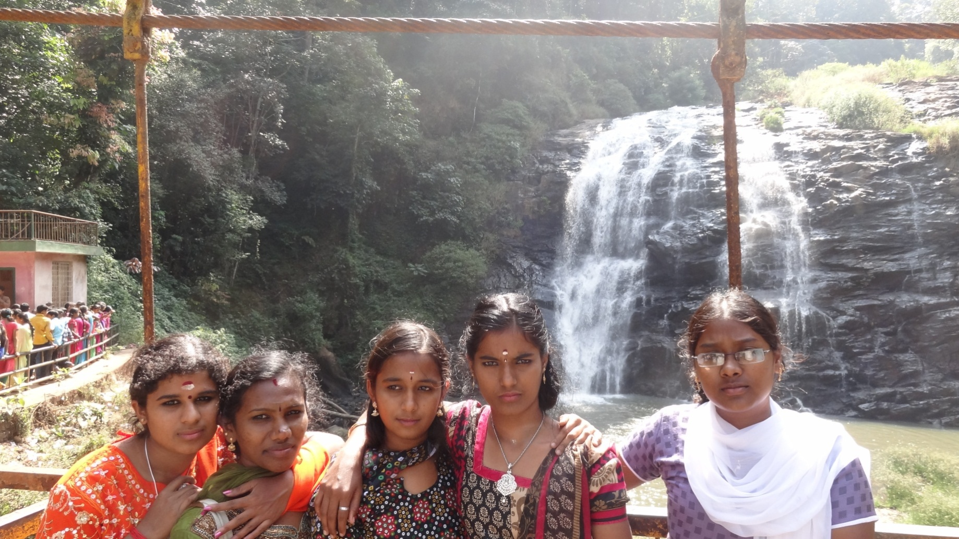
EDUCATIONAL TOUR - COORG
ABBEY FALLS (07.01.2015)

Slide 20
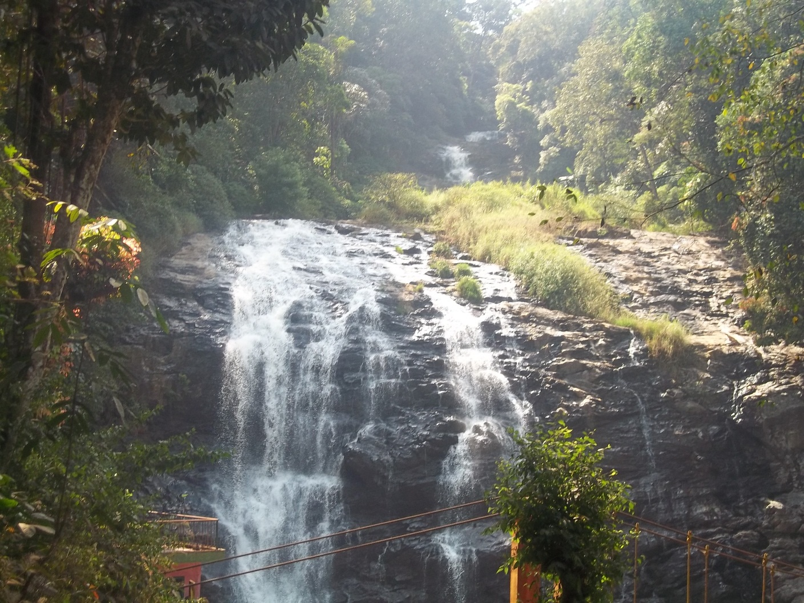
EDUCATIONAL TOUR - COORG
ABBEY FALLS (07.01.2015)

Slide 21
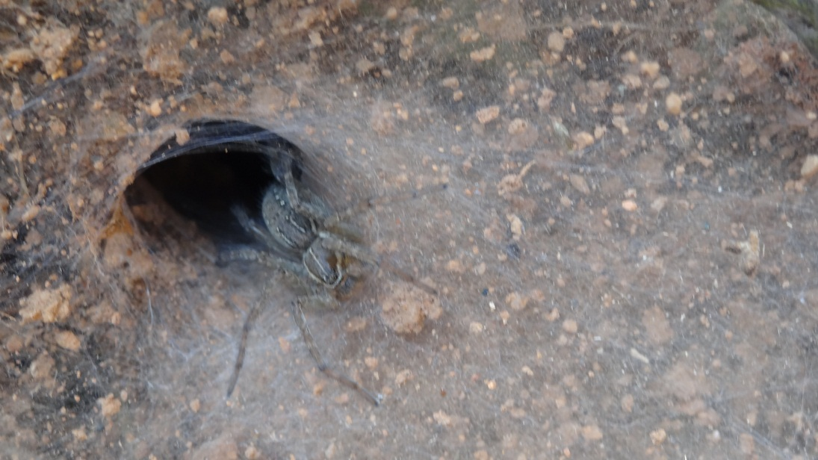
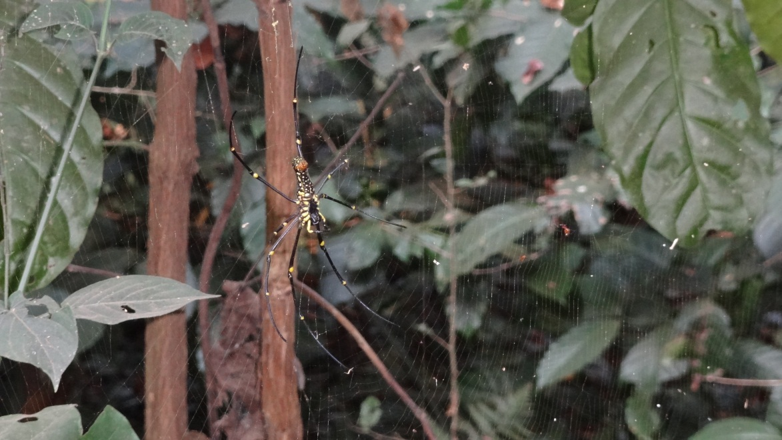
EDUCATIONAL TOUR - COORG
ABBEY FALLS (07.01.2015)

Slide 22
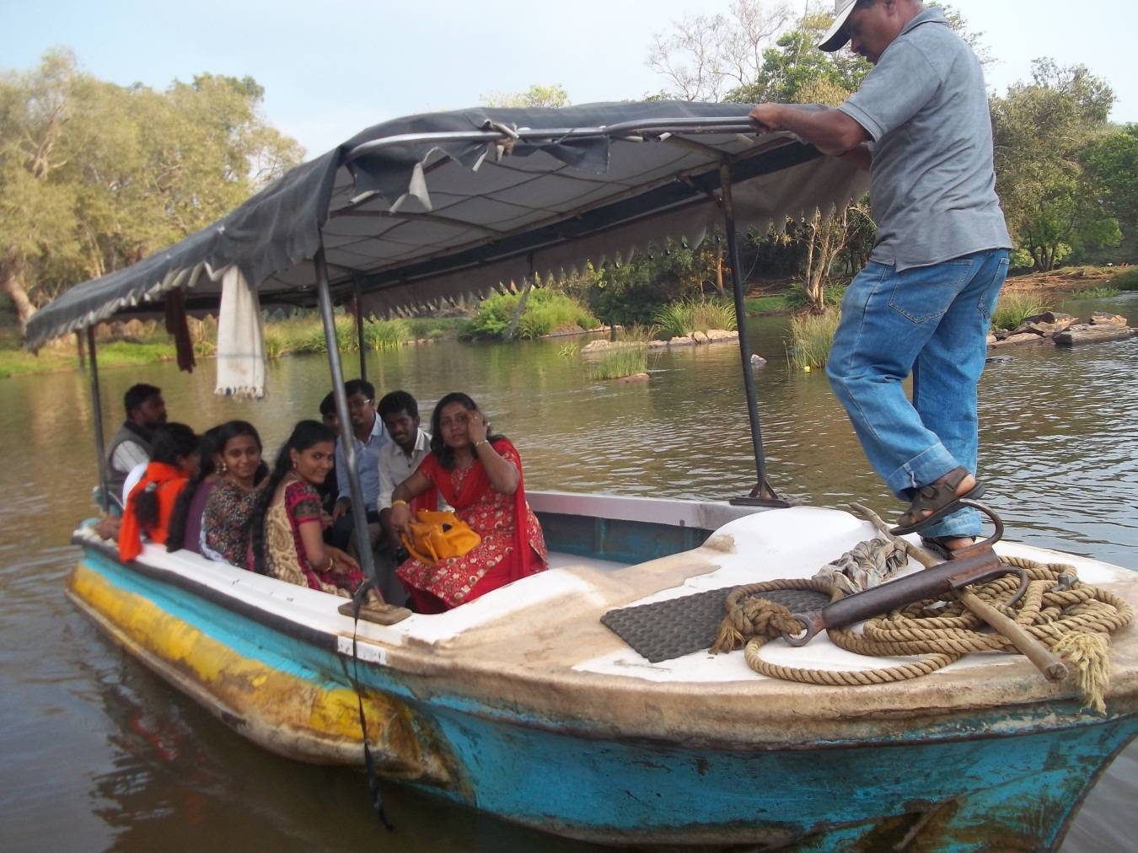
EDUCATIONAL TOUR - COORG
EN ROUTE TO DUBARE FOREST RESERVE & ELEPHANT CAMP (07.01.2015)

Slide 23
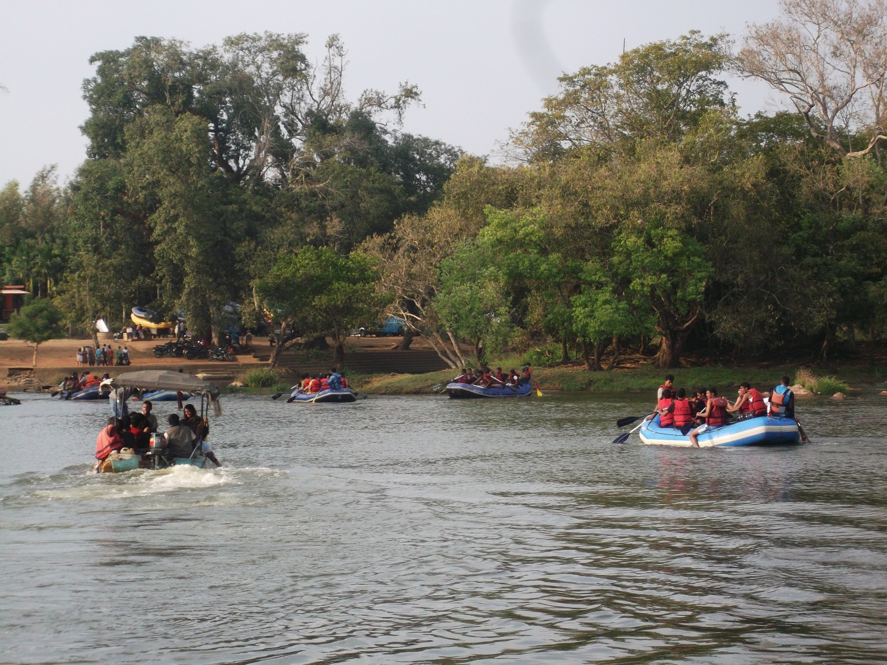
EDUCATIONAL TOUR - COORG
EN ROUTE TO DUBARE FOREST RESERVE & ELEPHANT CAMP (07.01.2015)

Slide 24
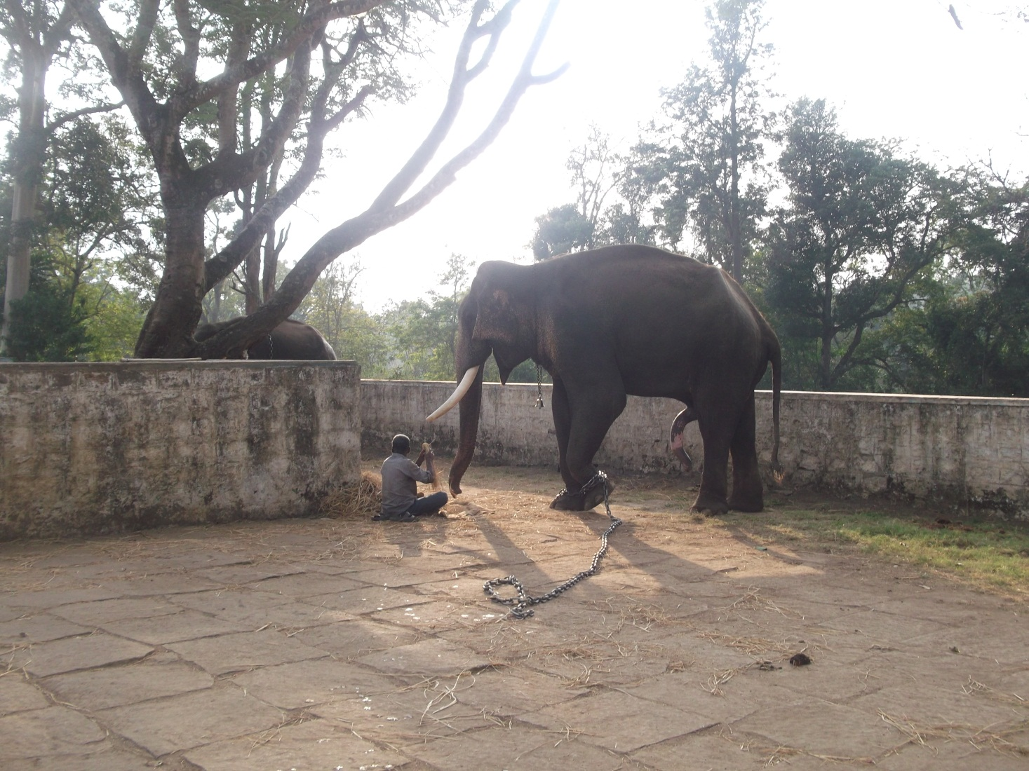
EDUCATIONAL TOUR - COORG
DUBARE FOREST RESERVE & ELEPHANT CAMP (07.01.2015)

Slide 25
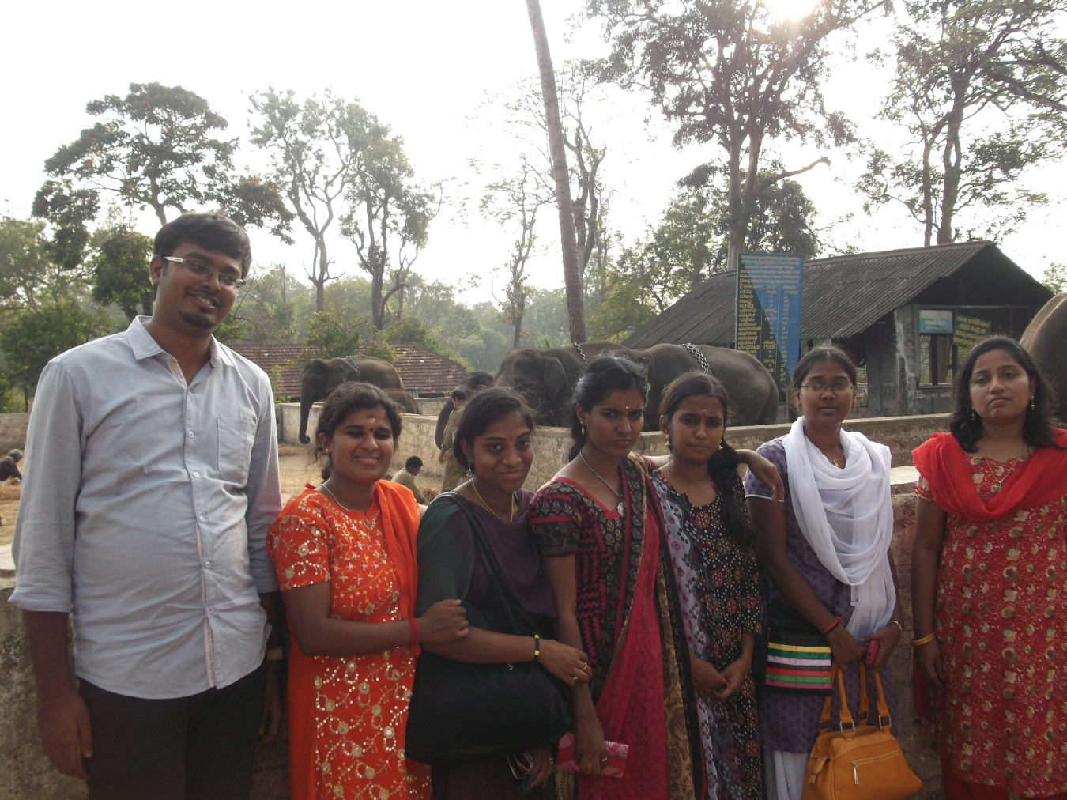
EDUCATIONAL TOUR - COORG
DUBARE FOREST RESERVE & ELEPHANT CAMP (07.01.2015)

Slide 26
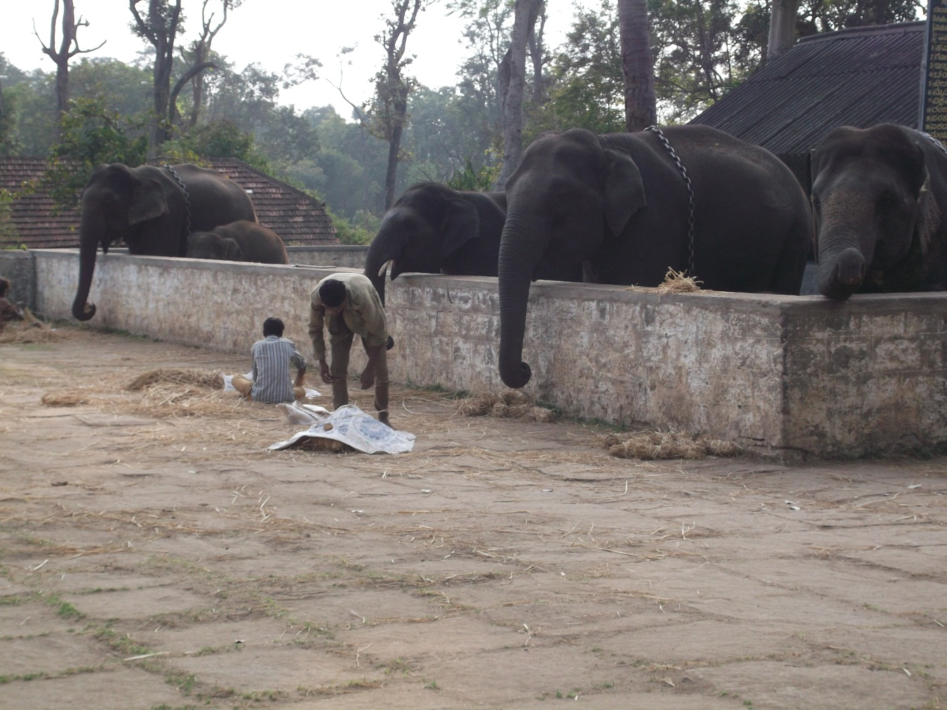
EDUCATIONAL TOUR - COORG
DUBARE FOREST RESERVE & ELEPHANT CAMP (07.01.2015)

Slide 27
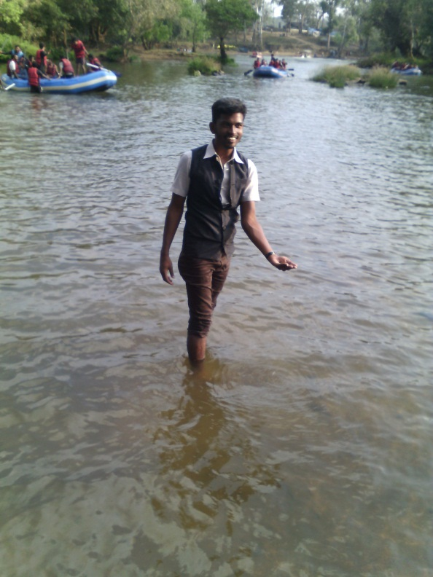
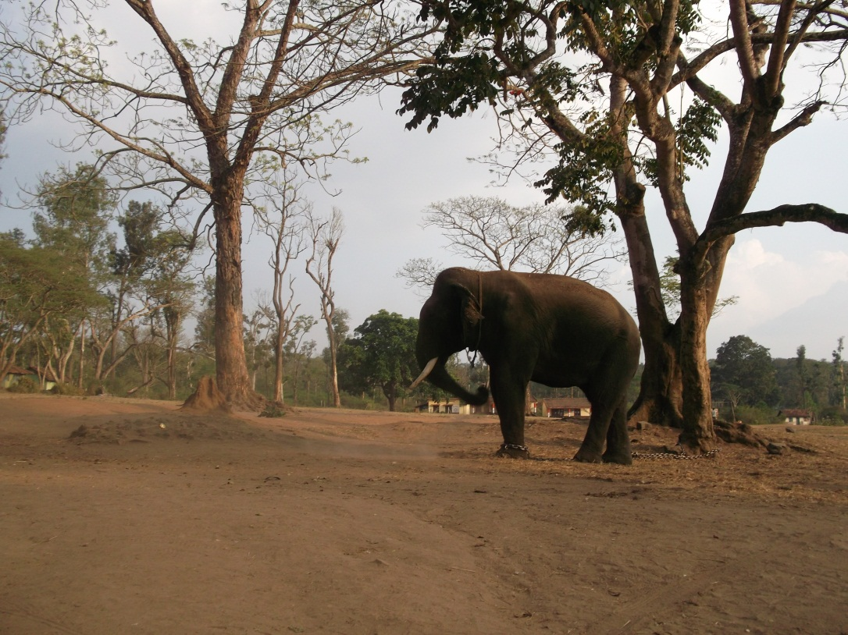
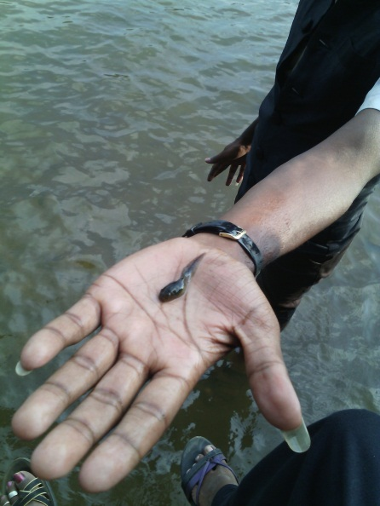
EDUCATIONAL TOUR - COORG
DUBARE FOREST RESERVE & ELEPHANT CAMP (07.01.2015)

Slide 28
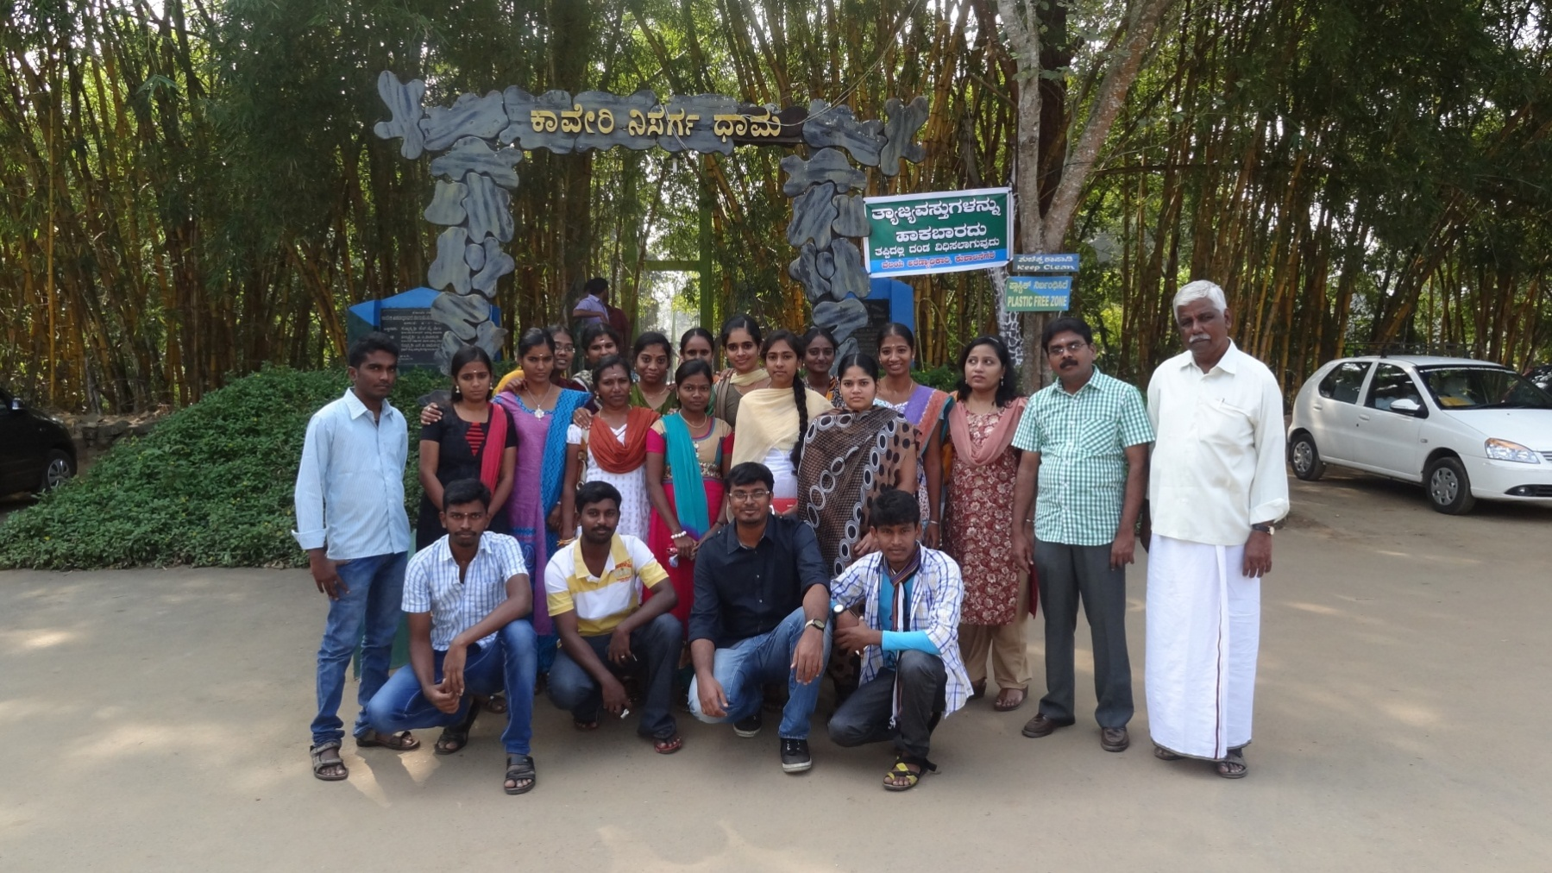
EDUCATIONAL TOUR - COORG
CAUVERY NISARGADHAMA ECOLOGICAL PARK (08.01.2015)

Slide 29
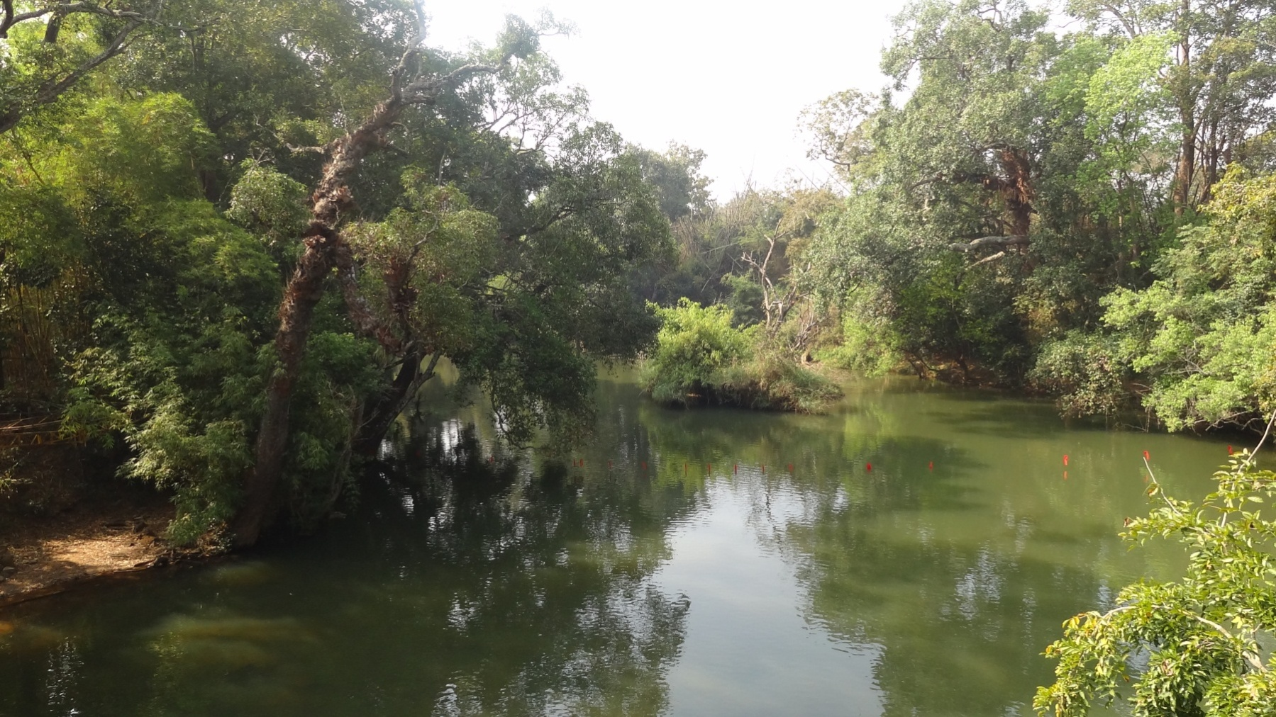
EDUCATIONAL TOUR - COORG
CAUVERY NISARGADHAMA ECOLOGICAL PARK (08.01.2015)

Slide 30
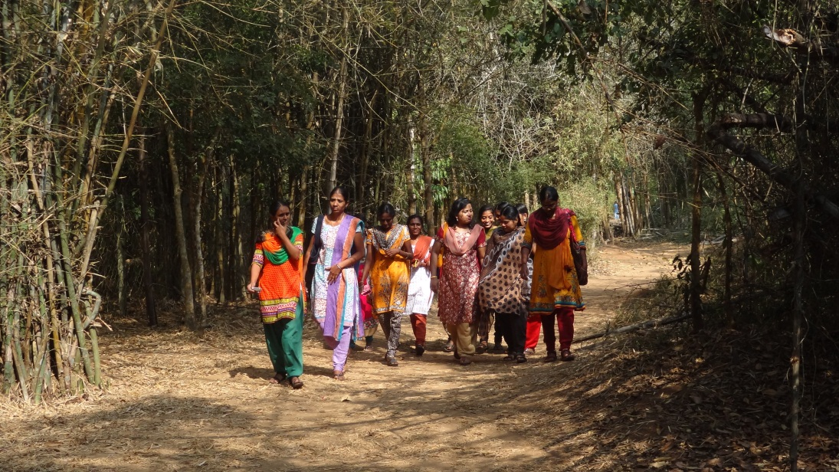
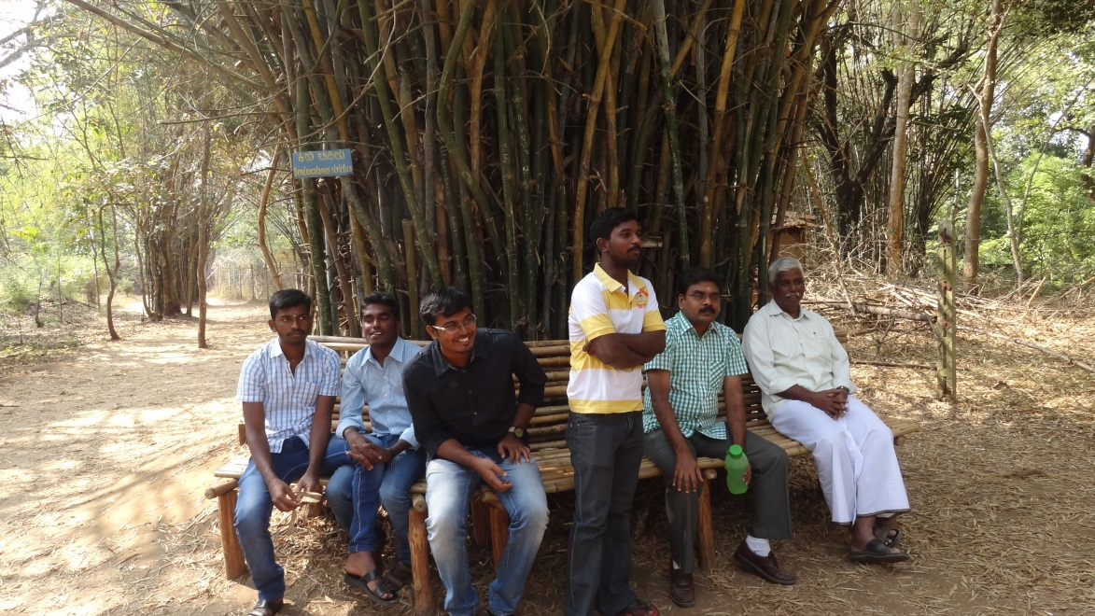
EDUCATIONAL TOUR - COORG
CAUVERY NISARGADHAMA ECOLOGICAL PARK (08.01.2015)

Slide 31
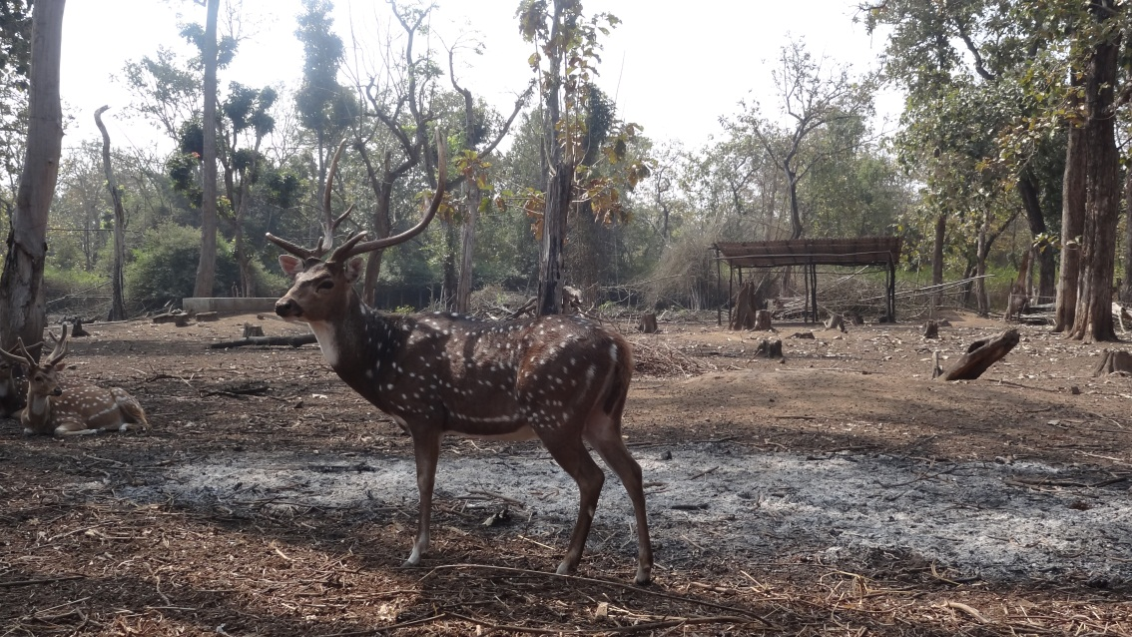
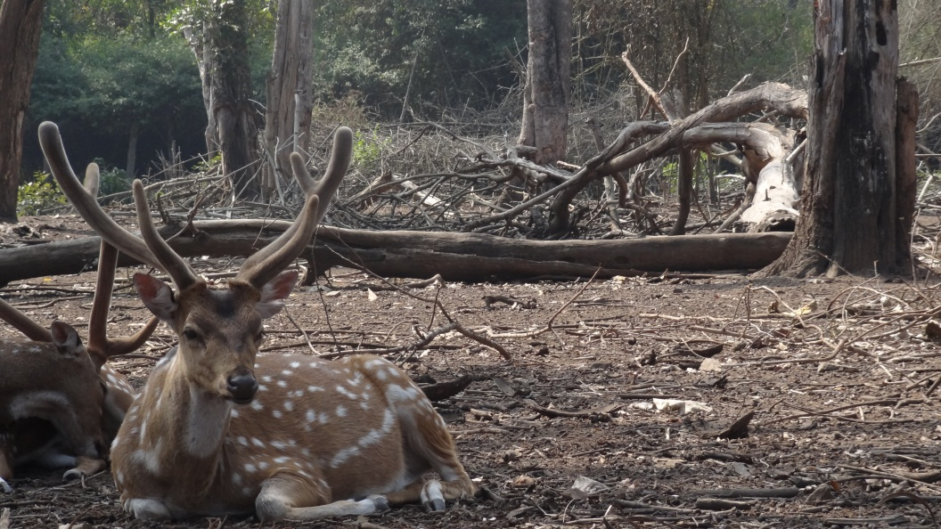
EDUCATIONAL TOUR - COORG
CAUVERY NISARGADHAMA ECOLOGICAL PARK
DEER PARK (08.01.2015)

Slide 32
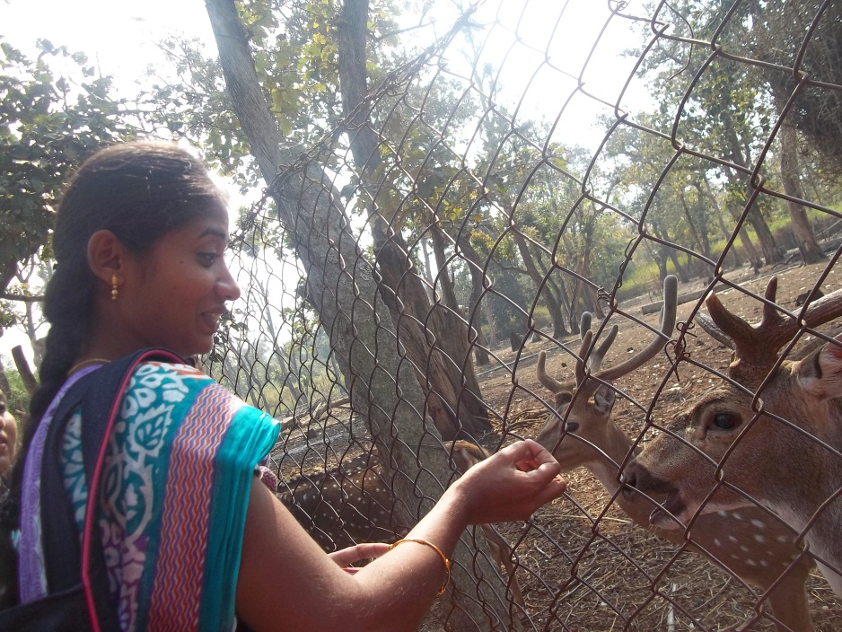
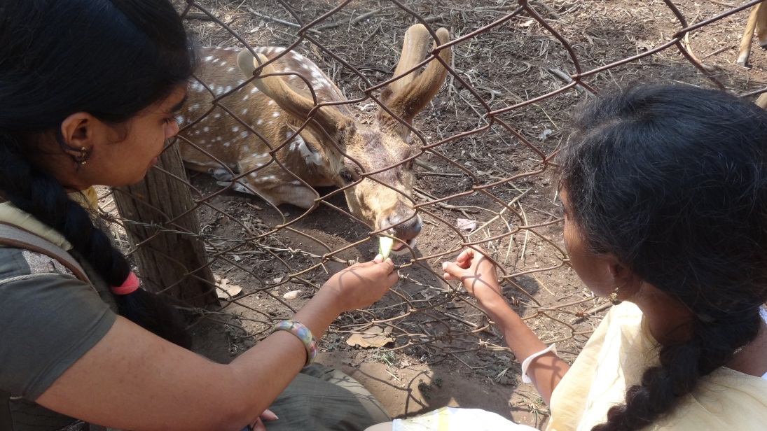
EDUCATIONAL TOUR - COORG
CAUVERY NISARGADHAMA ECOLOGICAL PARK
DEER PARK (08.01.2015)

Slide 33
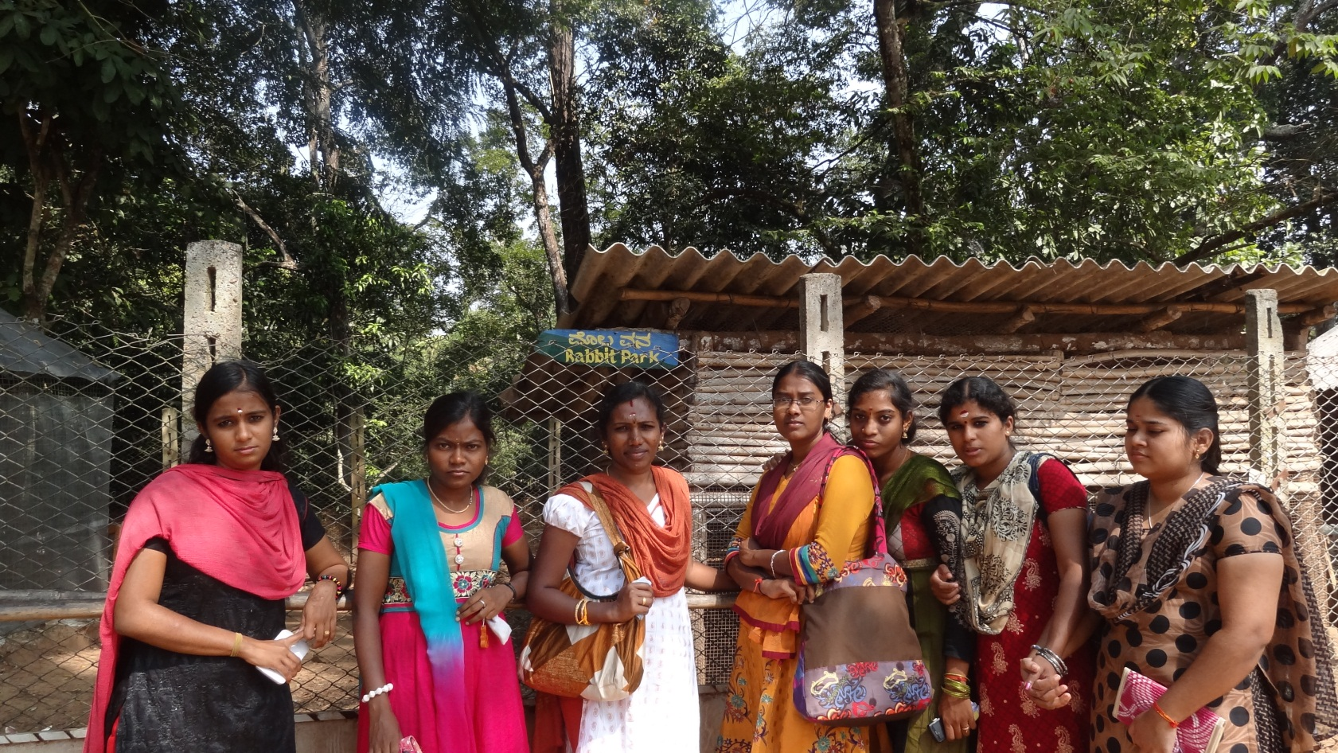
EDUCATIONAL TOUR - COORG
CAUVERY NISARGADHAMA ECOLOGICAL PARK
RABBIT PARK (08.01.2015)

Slide 34
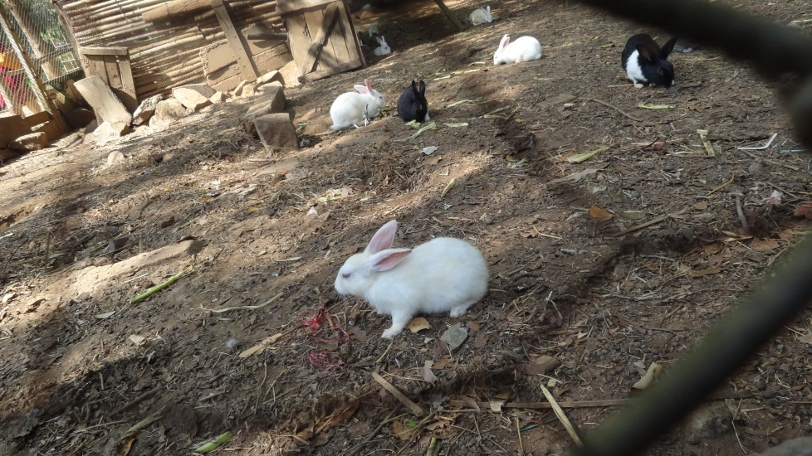
EDUCATIONAL TOUR - COORG
CAUVERY NISARGADHAMA ECOLOGICAL PARK
RABBIT PARK (08.01.2015)

Slide 35
EDUCATIONAL TOUR - COORG
CAUVERY NISARGADHAMA ECOLOGICAL PARK
ELEPHANT RIDE (08.01.2015)

Slide 36
EDUCATIONAL TOUR - COORG
CAUVERY NISARGADHAMA ECOLOGICAL PARK
ELEPHANT RIDE (08.01.2015)

